Slide 1
English Music Mood Classifier Using Ensemble Learning
Pattern Lab Project Intro

Slide 2
Presented By
Nusrat Jahan Asha 011152057
Shamima ferdouse Progga 011152192
Mirza Saudia Islam 011152199
Safiqul Islam 011142068
Md. Imran 011151075
N M Mubashir Khaled 011162145

Slide 3
Approach
Using ensemble learning methods
Combine decisions from multiple model
Ensemble technique with Support Vector Machine (SVM)
Minimizing noise bias and variance

Slide 4
Million dataset
The Million Song Dataset is a freely-available collection of audio features and metadata for a million contemporary popular music tracks.

Slide 5
Million Song dataset
MSD is a collection of audio features and metadata for a million popular songs. You can read about the specifics of these features and data at The Echo Nest’s site (Echo Nest API Overview), but essentially you’re provided with a few global features such as tempo, time signature, and key signature as well as lists of temporally marked features for beat locations, section locations, and segment locations. The segment feature provides MFCC values (or MFCC-like values) which are good for estimating musical timbre. By using the segment feature one is able to get a rough estimation of how the song’s timbre changes through time. This is arguably the most useful and most often used feature from the dataset

Slide 6
Sampling & labeling
Sampling is a tool that is used to indicate how much data to collect and how often it should be collected.
This tool defines the samples to take in order to quantify a system, process, issue, or problem.
Sampling is used any time data is to be gathered.Data cannot be collected until the sample size and sample frequency have been determined.
Sampling should be periodically reviewed.

Slide 7
Sampling & labeling
Labeling in Machine learning is tagging the group of samples with one or more labels.
Basically creating an identity for them.
This identity is used for supervised learning and creating a model based on this identity

Slide 8
Ensemble technique
Ensemble methods is a machine learning technique that combines several base models in order to produce one optimal predictive model.

Slide 9
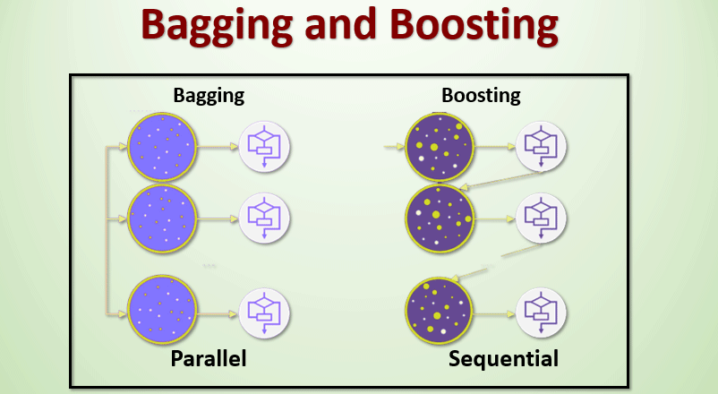
Ensemble Techniques

Slide 10
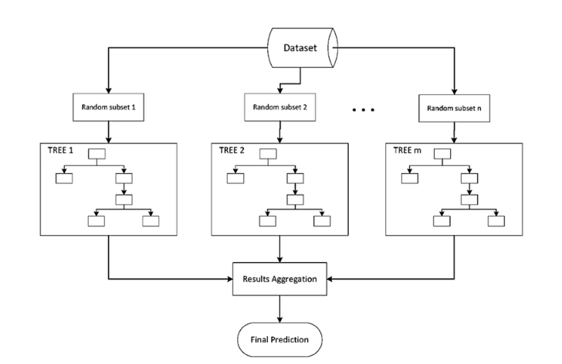
Bagging
Bootstrap Aggregating is an ensemble method. First, we create random samples of the training data set with replacement (sub sets of training data set). Then, we build a model (classifier or Decision tree) for each sample. Finally, results of these multiple models are combined using average or majority voting.

Slide 11
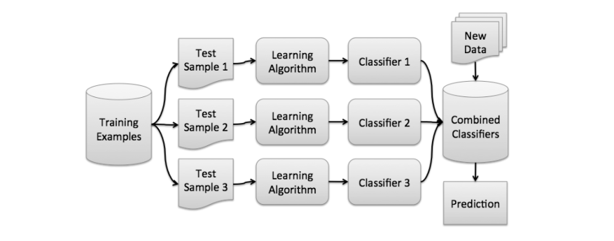
Bagging

Slide 12
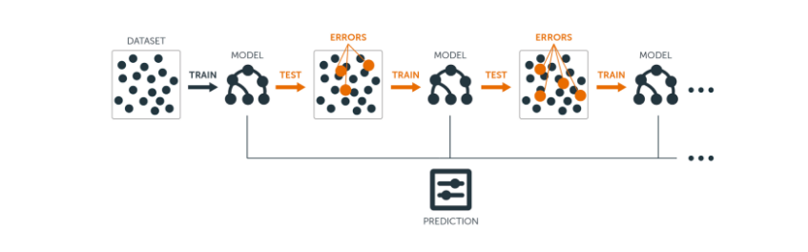
Boosting
Boosting in general decreases the bias error and builds strong predictive models. Boosting has shown better predictive accuracy than bagging, but it also tends to over-fit the training data as well. Thus, parameter tuning becomes a crucial part of boosting algorithms to make them avoid over fitting

Slide 13
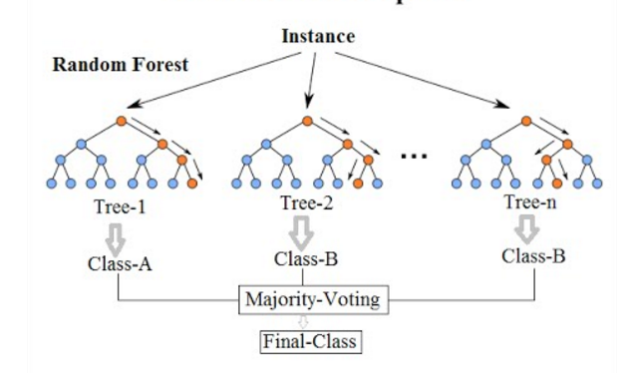
Random Forest
each decision tree in the forest considers a random subset of features when forming questions and only has access to a random set of the training data points.

Slide 14
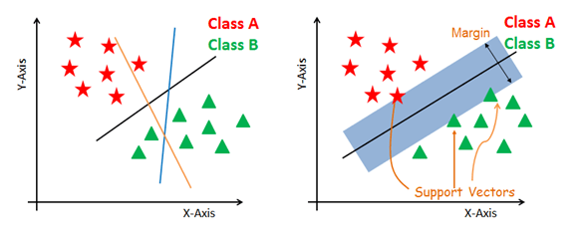
Support Vector Machine (SVM)

Slide 15
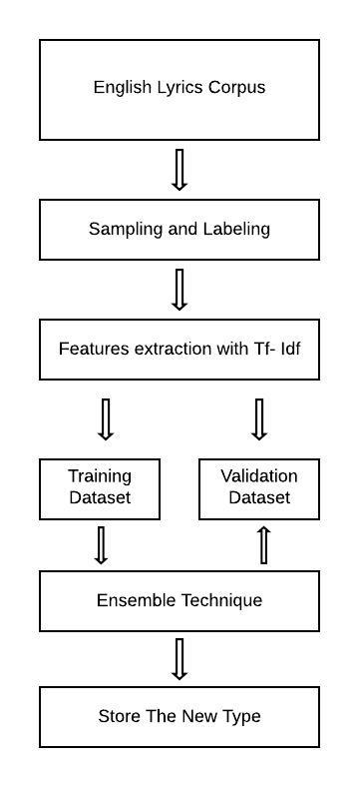
Flowchart of the project

Slide 16
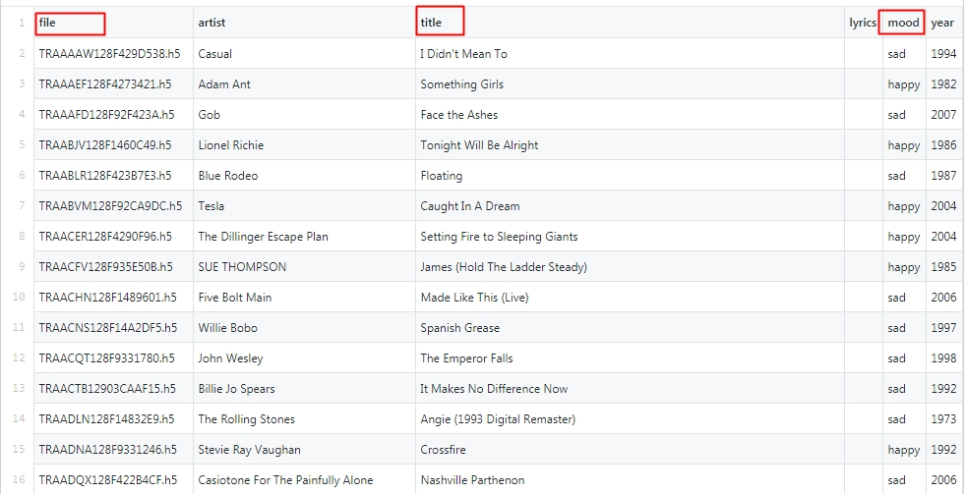
Dataset

Slide 17
Dataset Details
Total 1001 Rows
Features: Lyrics (In h5 file), Mood (Class Label), Title

Slide 18
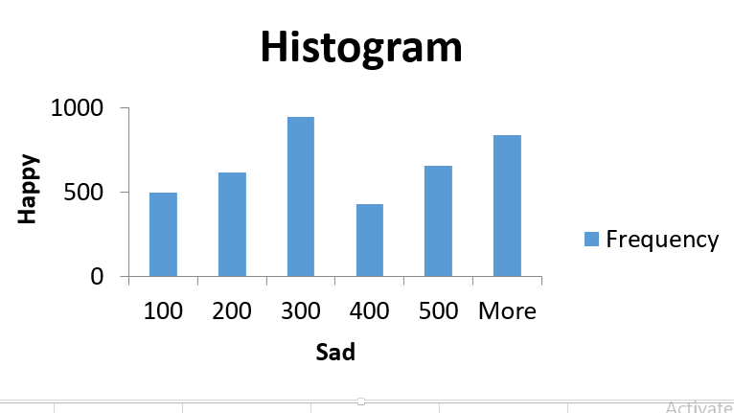

Slide 19
TF-IDF: Term Frequency-Inverse Document Frequency
What is TF-IDF? Why in Machine Learning?
TF-IDF calculation Applications:
TF calculation (1) Information Retrieval
IDF calculation (2) Keyword Extraction
Mathematical Terms: If, TF-IDF score for the word t in the document d from the document set D then it calculates as follow,

Slide 20
Thank You

